Slide 1

OYO Case Study - Data Analysis & Insights
Booking Trends, Revenue Patterns, and Recommendations
A Research Project by Satyam KUMAR| April 2025

Slide 2

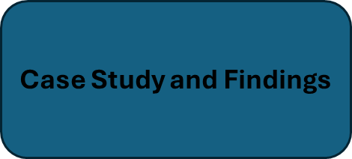
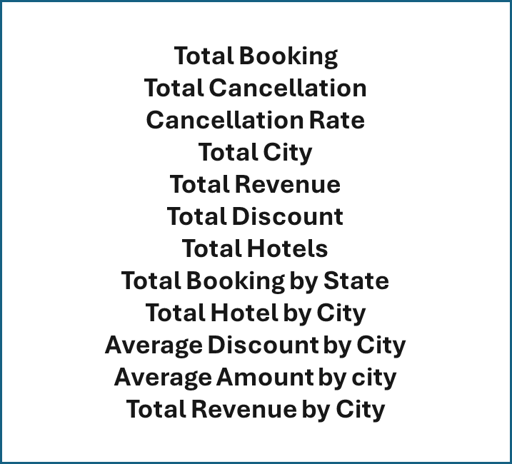
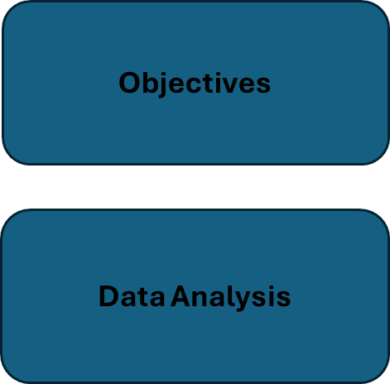

Contents

Slide 3
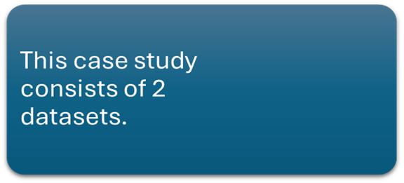
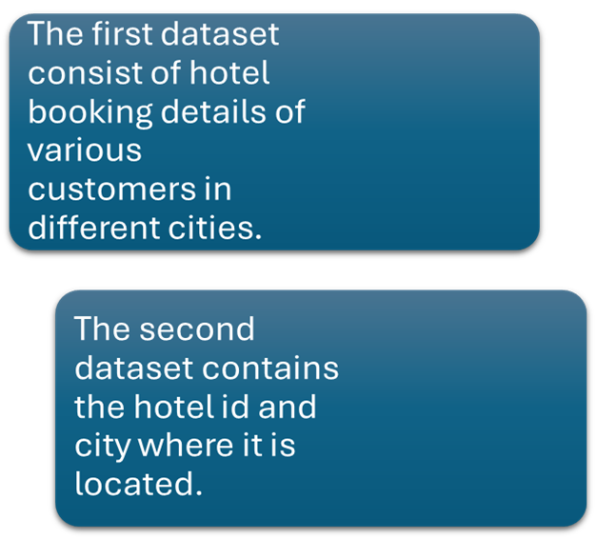
CASE STUDY

Slide 4
Objectives
Analyse the Bookings for the given time period.
Present findings based on data analysis.

Slide 5

Data Analysis
=> For analysis the data various facts affecting the business (i.e. the important attributes ) should be listed out.
=> In this case study, there are 2 tables oyo_location (consisting of hotel_id and city which the hotel is located) while oyo_bookings (consisting of many tables).

Slide 6
Table Analysis
=> This dataset consists of 2 tables.
=> This dataset consists of booking in the first quarter of the year 2017.
=> It consists of 357 different hotels across 10 different cities.

Slide 7
No. of hotels in different cities
Delhi, Bangalore, Gurgaon, Mumbai have more hotels.
Kolkata, Chennai, Pune have lesser number of hotels.

Slide 8
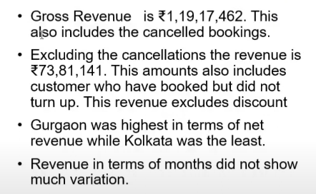
Total Revenue by City

Slide 9
Average Price by City
Mumbai have highest average oyo room price while Gurgaon have lowest average price.

Slide 10
Average Discount by City
Mumbai city oyo hotels gives maximum discount and OYO hotels in Gurgaon offer the lowest discounts
# Total discount of all the cities is
2589253.

Slide 11
Total Booking & Cancellation

Slide 12
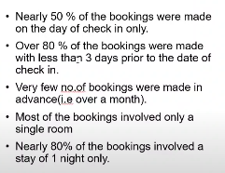
NATURE OF BOOKING

Slide 13
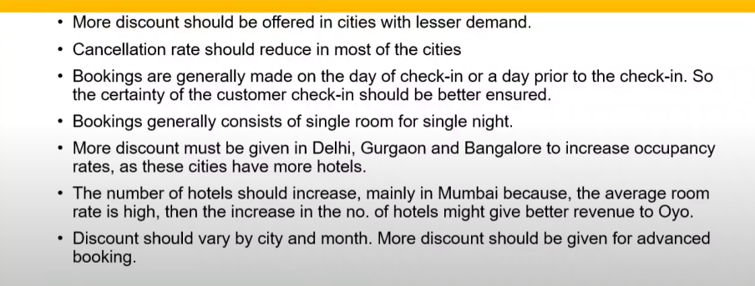
FINDING

Slide 14
📌 Actionable Recommendations
Optimize Pricing Strategy Across Cities
Since Mumbai has the highest average room price and discount, consider testing lower prices or reduced discounts to find the optimal revenue point.
Conversely, increase prices slightly in Gurgaon to boost revenue, as it has the lowest average price but also the lowest discount — a price-value mismatch may be affecting bookings.
Increase Marketing in Underperforming Cities
Cities like Kolkata, Chennai, and Pune have fewer bookings and hotels. Launch targeted marketing campaigns and local partnerships to raise awareness and increase demand in these locations.
Improve Booking Conversion & Reduce Cancellations
If cancellation data is significant, implement flexible booking policies and early bird or non-refundable discounts to lock in more confirmed bookings and reduce revenue loss from cancellations.

Slide 15

THANK YOU
Satyam Kumar
Email- kumarsatyam00283@gmail.com
LinkedIn- www.linkedin.com/in/satyam2006

